Slide 1
System Life cycle
17th Jan 2019

Slide 2
Guiding Principles for System
System acceptability is determined by user satisfaction;
user satisfaction is determined by five User criteria:
1. Provide value—meaning operational utility.
2. Fit within the user’s system and mission applications— meaning operational suitability.
3. Be available to conduct missions—meaning operational availability.
4. Accomplish performance objectives—meaning operational effectiveness.
5. Be affordable—meaning cost effectiveness.
Principle 6.2 Despite the most technically innovative and elegant SE design solutions, Users’ perceptions of a system, product, or service constitute reality.

Slide 3
System Verification and Validation
• Engineering of the system
– Conversion of users vision to an operable system
• System integrity
– Confidence in the performance of the system
• Reproducibility of the system

Slide 5
System Validation process
System inventory and assessment – determination of which systems need to be validated
User requirement specifications – clearly defines what the system should do, along with operational (regulatory) constraints
Functional requirement specifications – clearly defines how the system will look and function for the user to be able to achieve the user requirements.
Validation Plan (VP) – defines objectives of the validation and approach for maintaining validation status
Validation Risk assessments – analysis of failure scenarios to determine scope of validation efforts
Validation Traceability Matrix – cross reference between user and functional requirements and verification that everything has been tested.
Network and Infrastructure Qualification – documentation showing that the network and infrastructure hardware/software supporting the application system being validated has been installed correctly and is functioning as intended
Installation Qualification (IQ) Scripts and Results – test cases for checking that system has been installed correctly in user environment
Operational Qualification (OQ) Scripts and Results – test cases for checking that system does what it is intended to do in user environment
Performance Qualification (PQ) Scripts and Results – test cases for checking that System does what it is intended to do with trained people following SOPs in the production environment even under worst case conditions
Validation Report – a review of all activities and documents against the Validation Plan
System Release Documentation – documents that validation activities are complete and the system is available for intended use.

Slide 6
Stages in a System’s Life

Slide 7
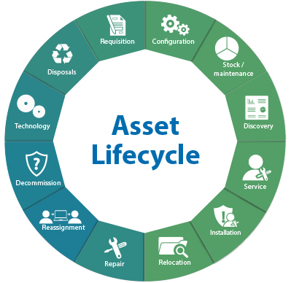
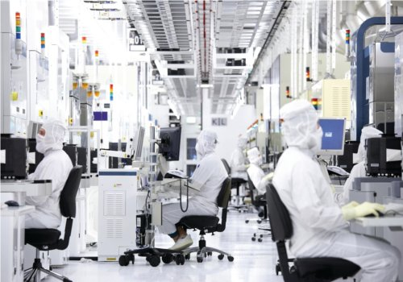
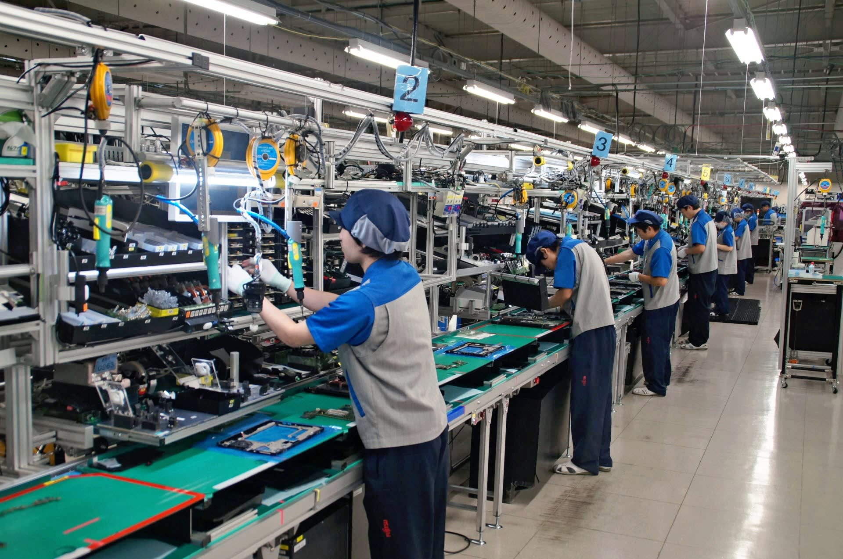
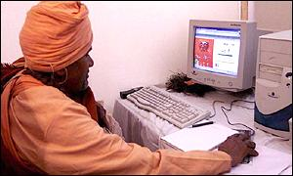
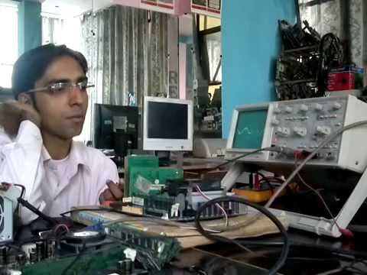
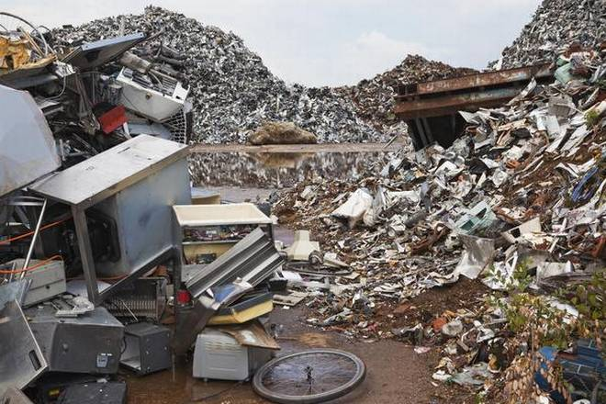
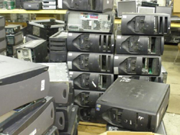
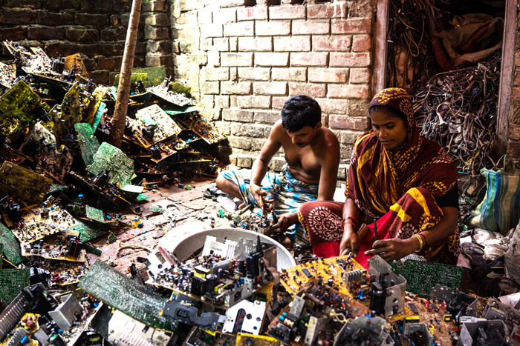
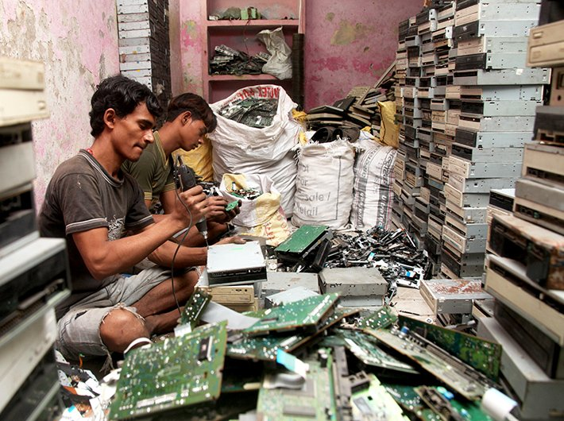
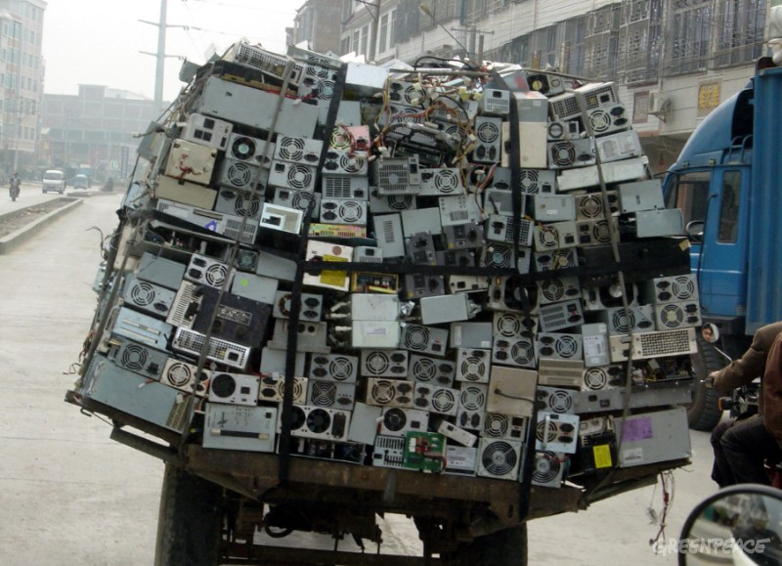
A hardware system’s life cycle
India ranks fifth in e-waste generation: UN report

Slide 8
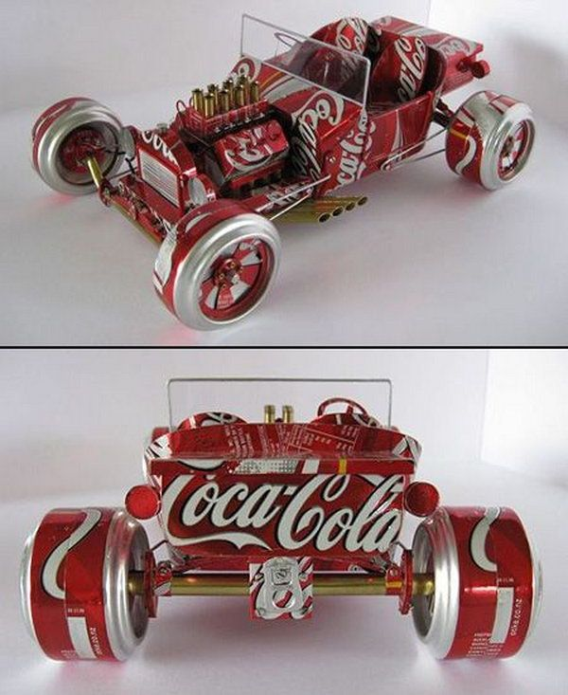
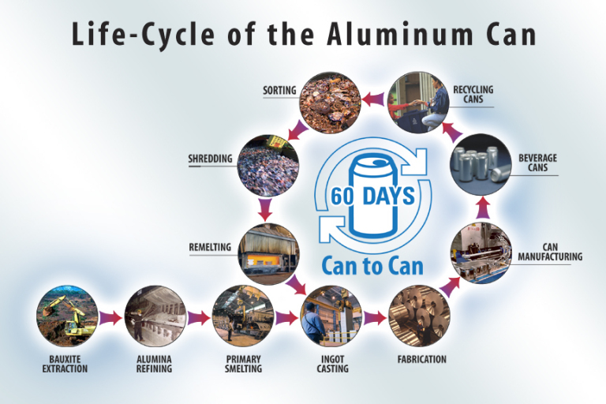
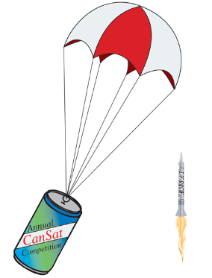
Life cycle of a soda can!

Slide 9
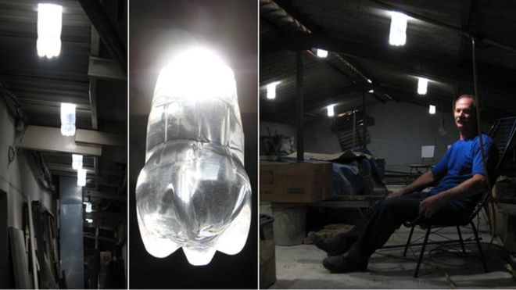
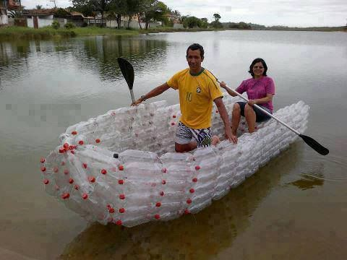
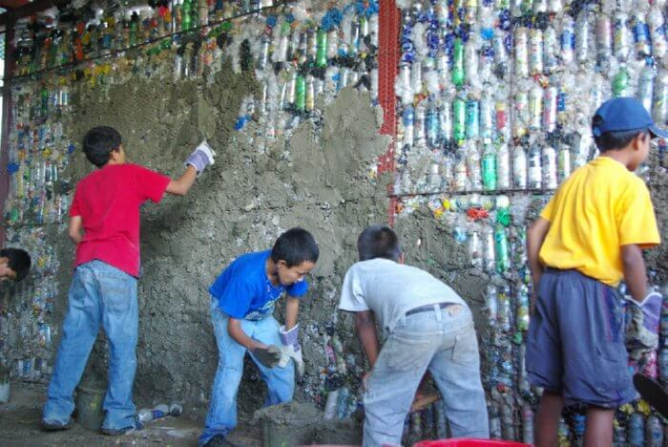
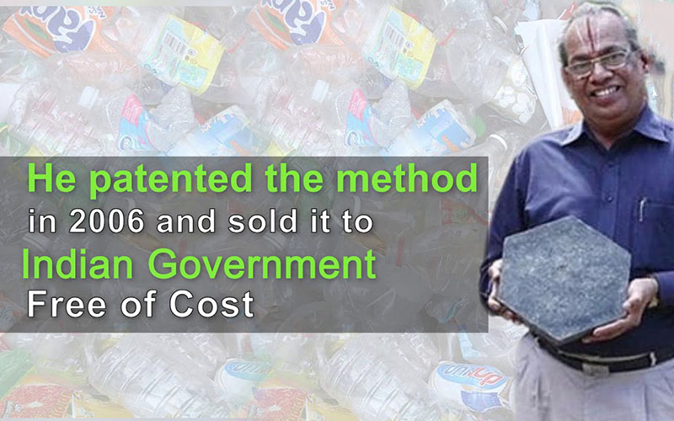
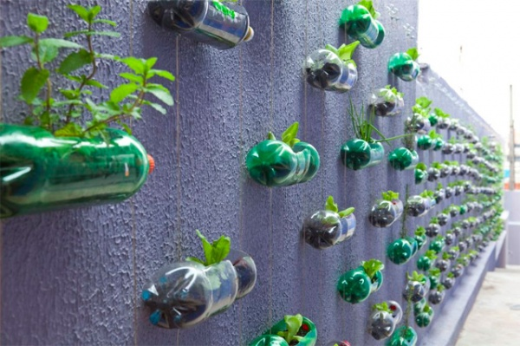
professor r vasudevan

Slide 10
Importance of a System Life Cycle to an SE
1. Line of Business the User is engaged in.
2. Opportunities, problems, or issues the User is chartered to address as part of its line of business. -opportunity space; specific targets as targets of opportunity (TOO).
3. Missions the User performs to support the LOB - solution space.
4. Capabilities are required to support solution space missions now and in the future.
5. Existing systems, products, or services the User employs to provide those capabilities.
6. Deficiencies or opportunities - exist in the current system, product, or service and how you and your organization can cost effectively eliminate those deficiencies with new technologies, systems, products, or services.

Slide 11
System Life Cycle
• System Definition Phase
1) mission opportunities, 2) threats, or 3) projected system capability and performance “gaps” or deficiencies.
• System Procurement Phase
• System Development Phase
• System Production Phase
• System Operations and Support (O&S) Phase
• System Disposal Phase

Slide 12
System Definition
1) mission opportunities,
2) threats, or
3) Projected system capability and performance “gaps” or deficiencies.
SWOT analysis:
Strength, Weakness, Opportunities and Threats
(Delhi metro. Source: Chapter 4, Thesis hosted on Shodhganga)

Slide 13
1.Cost effective mode of transport for the general public of Delhi.
2.Reduce congestion on roads making movement easier.
3.Reduce atmospheric pollution to a great level making environment healthy.
4.Ultra Modern technology and visually striking design, dynamic and modern, competitive and world class.
5. Reduce travel time: one hundred percent punctual operations.
6.Safer mode of transport for women.
7.The Voluntary International Standardization Organisation (ISO) 14,000 certification
Weakness
1.Metro considerably more expensive than the bus.
2.Less ridership than estimated.
3.High development cost.
4.Displaced many economic backward people.
5.Difficulties in acquiring land.
6.Difficult to expand network because of already existing structures
Strength
Opportunities
1.A struggle on part of those being displaced, and protests, petitions, hunger strikes, negotiations and
legal action have all been initiated.
2. Security threat. Delhi being the capital city is particularly vulnerable to terrorist attacks.
3. Risk of cost over runs and ridership shortfalls.
4. Metro operations have had to be suspended several times in last year because of earthquake. Delhi
being in seismic zone IV, this also is a big threat to the operations of Metro.
5. Delhi Metro have had to take several measures to stop suicides on its tracks.
6.With the increase in network, Delhi Metro has been
witnessing frequent snarls and breakdowns.
Threats
1. Revenue from property development and advertisements.
2.Potential to achieve higher ridership.
3.The success of the Delhi Metro has encouraged other Indian Cities to seriously attempt to introduce
Metro Systems.
4.The upcoming Metro lines in the city will be 10 -
15 percent cheaper than the previous phases.
5.Delhi Metro has massive scope to increase its connectivity to the satellite towns of Bahadurgarh,
Faridabad, Gurgaon, Noida and Ghaziabad

Slide 14
System Procurement Phase
1. Qualifying capable system, product, or service vendors.
2. Soliciting proposals from qualified vendors (offerors).
3. Selecting a preferred vendor (offeror).
4. Contracting with the vendor to develop the system, product, or service.

Slide 15
System development Phase
1. System Engineering Design
2. Component Procurement and Development
3. System Integration, Test, and Evaluation (SITE)
4. Authenticate System Baselines
5. Operational Test and Evaluation (OT&E)
Each stage has an Entry and Exit criteria
Developmental Configuration
System Verification test
System Performance test

Slide 16
System Operations and Support
(O&S) Phase
• Initial Operational Capability (IOC)
• Full Operational Capability (FOC)
• operational service life
• Disposal

Slide 17
SE’s role
SE’s role as a problem solver- solution developer becomes crucial.
The challenge is how do SEs work with Users and Acquirers to:
1. Collaboratively identify and partition the opportunity space into one or more solution spaces,
2. Technically bound and specify the solution space in terms of capability and performance requirements that are legally sufficient to procure systems, products, and services,
3. Verify that the new system complies with those requirements,
4. Validate that the system developed satisfies the User’s original operational

Slide 18
Class exercise
As an SE, you have been tasked to work with government transport authority to convert the existing bus transport into an high-tech system – includes bus fleet, bus stops.
4) Existing systems, products, or services the User employs to provide those capabilities.
5) Deficiencies or opportunities - exist in the current system, product, or service and how you and your organization can cost effectively eliminate those deficiencies with new technologies, systems, products, or services
Hence, Specify the opportunity space - Opportunities, problems, or issues
the solutions space - Missions the User performs.
And the capabilities required to support solution space

